Slide 1
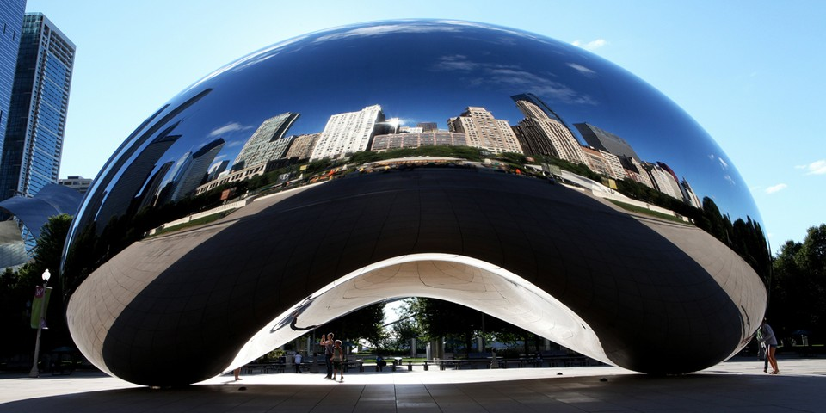

SOAP 2022
Annual Meeting
May 11-15, 2022
Chicago Hilton Hotel
SAVE THE DATE
CHICAGO
#SOAPAM2022
soap.org

